Slide 1

Empowering Digital Learning with a Study Organizer
Digital learning offers flexibility but also brings challenges in staying organized, motivated, and engaged. This project aims to create a student-friendly platform with powerful tools and intuitive design to enhance learning and boost academic success.
Team 9: Kshitij Dnyaneshwar Lavhe , Swethaa S P

Slide 2

Challenges
Current learning management systems (LMS) offer basic features like course access and grading but lack tools for personalized support. Students face challenges in managing assignments,notes, schedules, and motivation. This creates additional hurdles in adapting to digital education effectively.

Slide 3




Our Solution
1
Enhance Organization
2
Boost Motivation
3
Increase Engagement
4
Empower Students

Slide 4
Key Features
Dashboard
Note-Taking System
Assignment Management
Motivational quotes will be displayed on the dashboard to inspire students. The dashboard will also show the most recent note, the total number of notes, today’s assigned assignments, the total number of assignments, and the number of assignments due today.
Students can efficiently create, edit, delete, and view notes, including a title, date, and additional resources such as links.
Students can track assignments including the assignment name, date, deadlines, tags, and description. Admin can assign assignments for students.
Session Tracking
Streaks Feature
Leaderboard
Students can view their sessions with details on title, date, resources, assignments, and description.
Students can track their progress with their streak increasing when they submit an assignment before the deadline.
Students can view the top performers based on their streaks, encouraging friendly competition and recognition.

Slide 5
Security Features
Authentication
Token Validation
Auth Guard
Handles user registration, login, and token issuance. API Gateway validates tokens, enforces JWT with role-based claims, and routes requests to the appropriate service.
Token validation at the API Gateway using Ocelot.
Used Auth Guard to secure routes and protect user data. Only authenticated users can access certain pages or features. Stops unauthorized users from accessing protected areas. Improves user experience by redirecting unauthenticated users to the login page.

Slide 6



Technology Stack
Frontend: Angular
Backend:ASP.NET Core
Database: SQL Server

Slide 7
Workflow
Login and Signup:
1
Secure login for students to access the app.
2
Note taking Feature:
Students can create, edit, view, and delete their notes.
Session tracking Feature:
3
Students can create, edit, view, and delete their sessions to keep track and notes of sessions
4
Assignment Feature:
Trainer can assign assignments to students.Students can view it and submit the assignments.
Engagement Tools:
5
Streaks and leaderboard features keep students motivated.

Slide 8
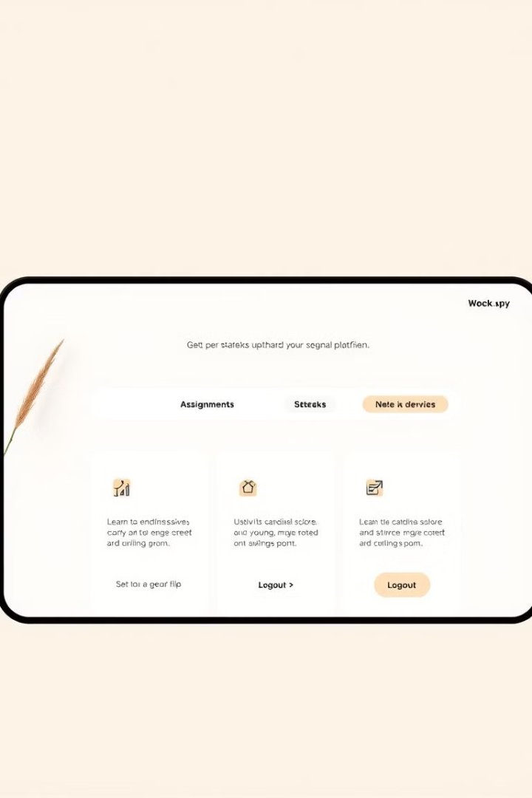
Conclusion
Our project tackles key challenges in digital learning: organization, motivation, and engagement. With a strong tech stack and user-focused design, it offers tools like note-taking, assignment management, and session tracking. Features like streaks and leaderboards enhance the learning experience and keep students motivated.

Slide 9

Next Steps
Collect feedback from students to enhance the app.
Focus on improving key features like notes, assignments, and streaks.
Integrate free resources and deploy the app on Azure for better accessibility.
Continuously refine the app based on user suggestions to meet their needs effectively.

